Slide 1


WELCOME AT
PTV Group.
Name
Ort, Datum
www.ptvag.com

Slide 2
PTV xServers 1.14
Technical Workshop
PTV xServer stakeholders
Name
Ort, Datum

Slide 3
Application development → speed profile
CLASS | network class NC
0 | Motorway
1 | Highway
2 | Trunk road
3 | Country road
4 | City street
5 | Residential street
6 | Driveable but normally blocked roads
7 | Cycle lanes and walkways
SC_0 | SC_7
135 | 70
125 | 35
85 | 25
60 | 25
50 | 20
40 | 18
16 | 9
6 | 4
CLASS | speed class SC
0 | Fastest
1 | Faster
2 | Fast
3 | Medium fast
4 | Medium slow
5 | Slow
6 | Slower
7 | Slowest
64 possible combinations
SPEED_PROFILE=135,70,125,35,85,25,60,25,50,20,40,18,16,9,6,4
Based on kilometers / hour
Notes:
Within the data model of the so-called PTV tiled maps each street segment belongs to
one out of 64 available categories based on 8 network classes and 8 speed classes (within a network class).

Slide 4
.. → speed profile / VMax
 | SC_0 | interpolated | SC_7
NC_0 | 135 | … | 70
NC_1 | 125 | … | 35
NC_2 | 85 | … | 25
NC_3 | 60 | … | 25
NC_4 | 50 | ... | 20
NC_5 | 40 | … | 18
NC_6 | 16 | … | 9
NC_7 | 6 | … | 4
70→79→88→97→106→115→124→133
Notes:
By specifying the minimum and maximum speed values within each network class all the other speed classes are defined via linear interpolation.
Furthermore the vehicles maximum speed is used to cut the speed classes.

Slide 5
Segment costs
Length
NC / SC
approximation formula
OPT x TIME x 10 + (100 - OPT) x DIST
100
SPEED_PROFILE
Length
Driving time
OPTIMIZATION
Initial
Cost value
OPT == 0 | DIST
OPT == 50 | 0.5 x (TIME x 10 + DIST)
OPT == 100 | TIME x 10
MALUS(NC,SC,..)
Temporary
Cost value
Notes:
The segments basic properties are length, speed class and network class.
The so-called costs of a segment are then derived in the following process:
The driving time depends on the speed profile
The initial costs are computed based on the approximation formula (the slide does not show the exact formula, this is confidential)
If the segment belongs to a category such as highways, tollroads, residential, … a correction factor called malus is applied (see also next slide)

Slide 6


Segment costs
70
Length
NC / SC
80
60
SPEED_PROFILE
Length
Driving time
40
60
North = 80 x 1.00+70 = 150
South = 60+40 x 1.00+60 = 160
North = 80 x 1.25+70 = 170
South = 60+40 x 1.25+60 = 170
North = 80 x 1.50+70 = 190
South = 60+40 x 1.50+60 = 180
OPTIMIZATION
Initial
Cost value
The „best“ route depends
therefore on the malus value!
MALUS(NC,SC,..)
Temporary
Cost value
Notes:
Depending on the „malified“ segments the cheapest track may be south or north.
The high ligthed sements belong to a malified category and their costs are therefore increased.
With a malus of 50% or higher the optimal track is no longer the northern track but the alternative southern track.

Slide 7
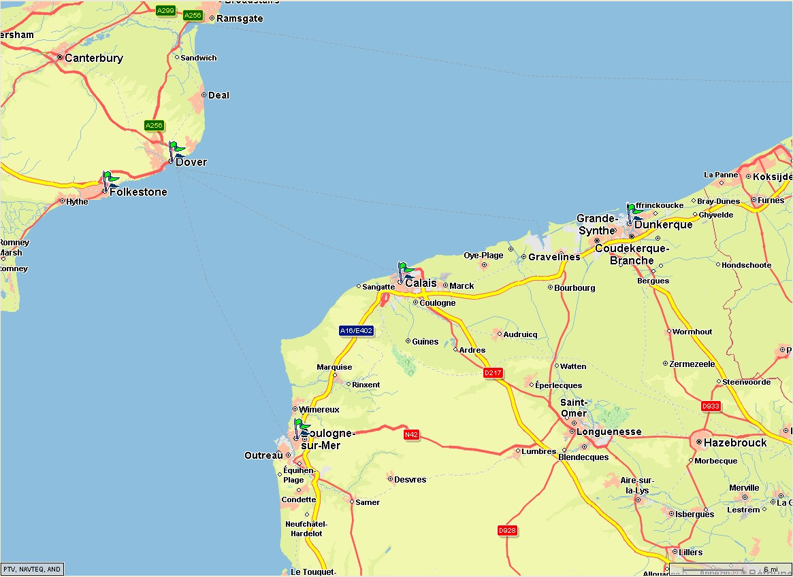
Beware of extreme values!
15 km
→15 min
OPT=0 !
15 km
45 km
→ 45 min
33 km
→33 min
Notes:
Be careful with extreme values of the optimization parameter:
Assigning optimization=0 does no longer consider driving time on ferries and therefore a ridiculous shortcut by ferry hopping may occur.

Slide 8
Beware of extreme values!
OPT=100 !
165 min
170min
120min
45 km
→ 45 min
Notes:
If the optimization parameter is too high it may happen that the detour via a adjacent town is „cheaper“ than a straight connection from where you are.

Slide 9
Name
Ort, Datum
www.ptvag.com

